Slide 1

Assam-Internet and mobile users data
Presented by:
Simranjeet Kaur

Slide 2
A quick brief about the concepts/tools I used for this analysis:
Started the analysis by finding the appropriate data.
Data source: https://trai.gov.in/sites/default/files/PIR_08012020_0.pdf
Extracted data from pdf tables using python tabula library, performed data cleaning, converted into dataframe and saved it in excel format.
Performed analysis in form of visualizations in excel.

Slide 3
Mobile users data

Slide 4
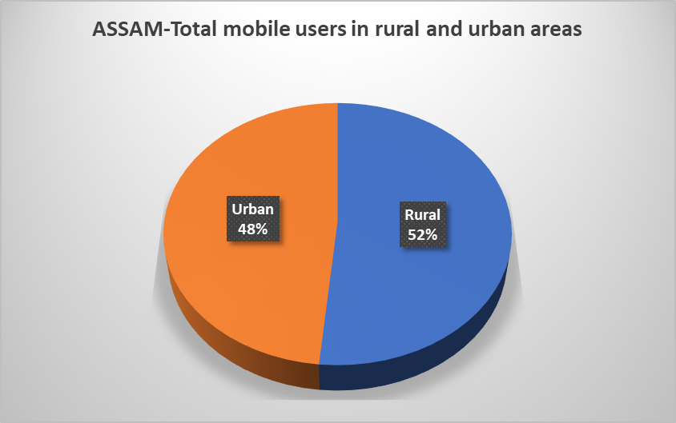
As per the report:
Total mobile users are: 24.1 million.
Out of which, Urban people who uses mobile are:11.7 million and rural mobile users are:12.4 million.

Slide 5
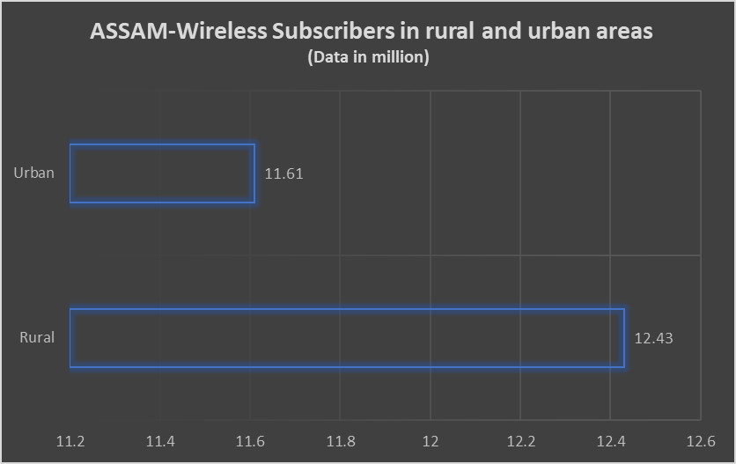
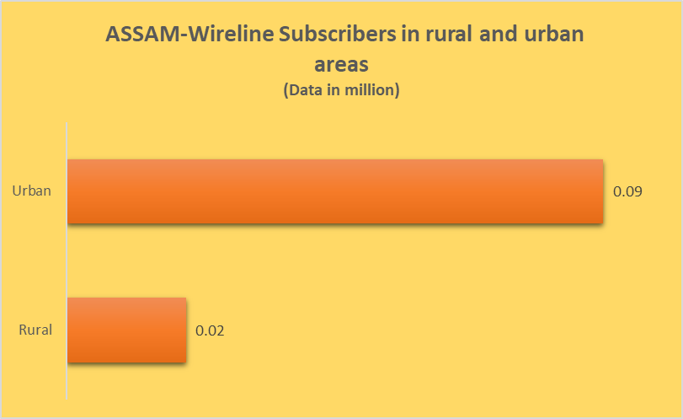
Mobile users are further classified as Wireless subscribers and wireline subscribers.
Wireless mobile users are more as compared to wireline.

Slide 6
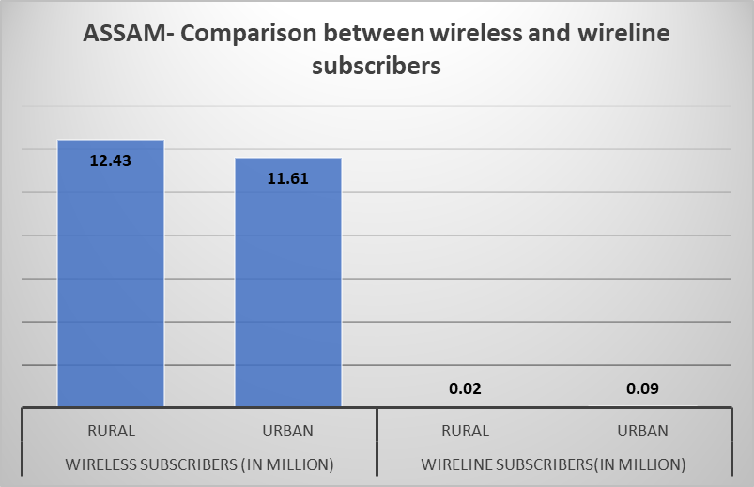
Single pictorial representation that compares both wireline and wireless mobile users.

Slide 7
INTERNET USERS DATA

Slide 8
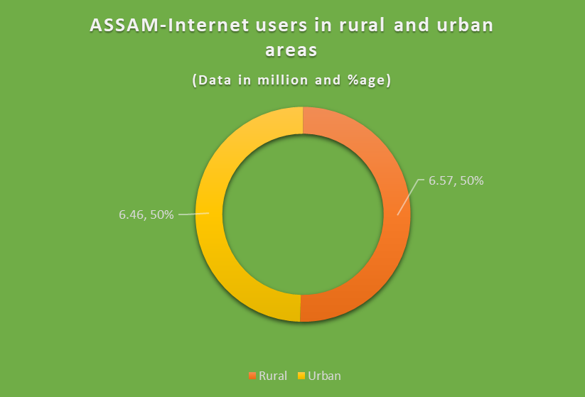
Total internet users in Assam are: 13.03 million.
Count of internet users from both rural and urban areas are almost same(mentioned in graph).

Slide 9
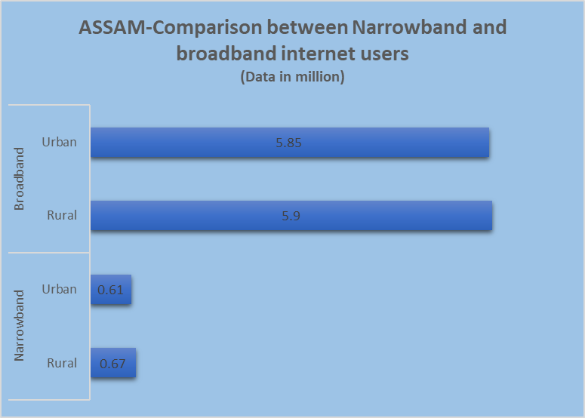
Key highlights:
- Internet users are further classified as narrowband and broadband users. - Broadband internet users are more in both urban and rural areas.

Slide 10
Thanks for considering!

